Slide 1
Mountainboard - Lesson 5
Thin Features – The Deck
School’s Name
Teacher’s Name
Date

Slide 2
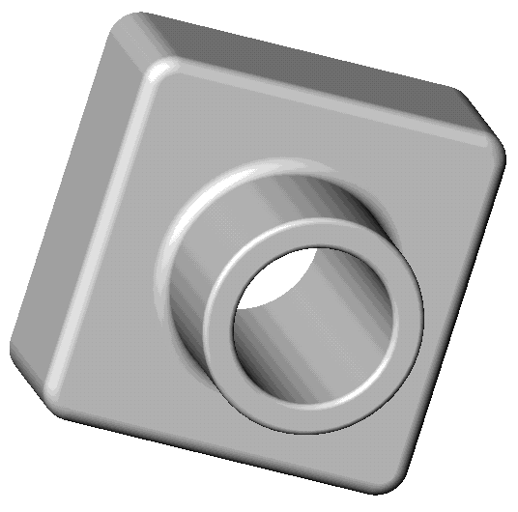
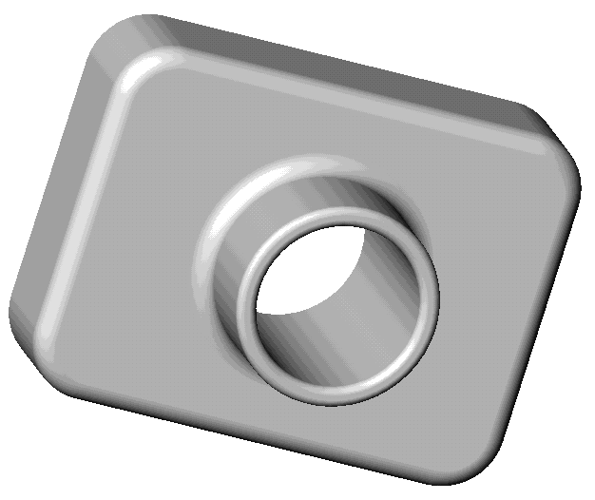
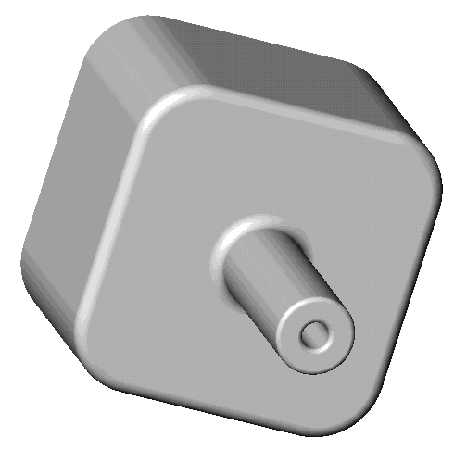
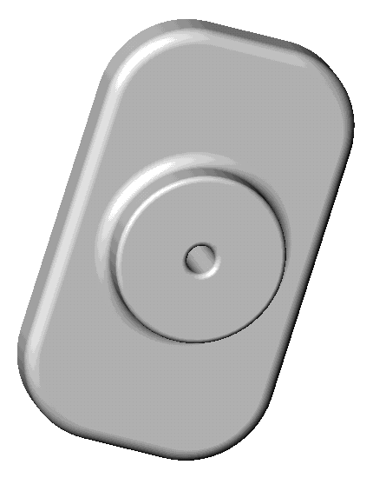
Families of Parts
Many times parts come
in a variety of sizes.
This is called a family
of parts.
It is not efficient to
build each version individually.
Design Tables simplify making families of
parts.

Slide 3
Design Table Overview
Design Tables are used to create different configurations of a part.
What is a Configuration?
  A configuration is a way to create a family of similar parts within one file.
  Each configuration represents one version of the part.
Design Tables automatically change the dimensions and features of an existing part to create multiple configurations. The configurations control the size and shape of a part.

Slide 4
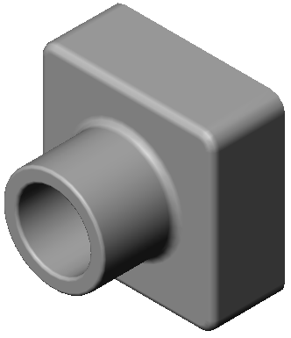
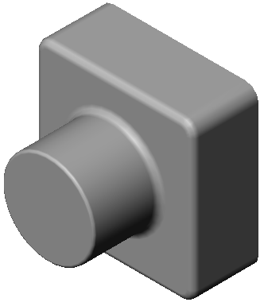
Design Table Overview
Design Tables can control the state of a feature.
The state of a feature can be suppressed or unsuppressed (also called resolved). A suppressed feature is not rebuilt or displayed.
Design Tables requires Microsoft Excel application.
Center hole suppressed

Slide 5
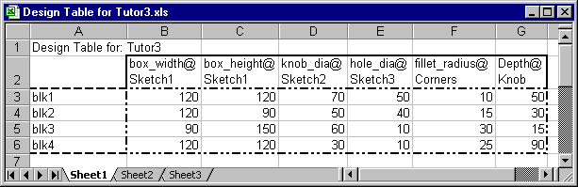
Design Tables Require
Dimension and/or Feature names
or special keywords
Configuration
Values
Tip: Rename features and dimensions before creating a design table.

Slide 6
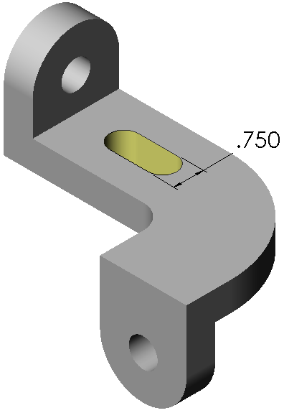
Rename Features and Dimensions
Feature and Dimension names used in a Design Table should be renamed to better describe their function.
Which is easier to understand?
  D1@Cut-Extrude1
  Width@Oval_Slot

Slide 7
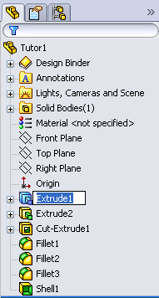
To Rename a Feature
Click-pause-click on Extrude1 in the FeatureManager design tree (do not double-click).
Tip: Instead of the click-pause-click technique, you can select the feature, and then press the function key F2.
The feature name is highlighted in blue, ready to be edited.
Type the new name, Box, and press Enter.

Slide 8
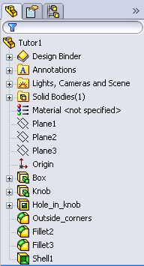
Rename the Other Features Used in the Design Table
Rename Extrude2 to Knob.
Rename Cut-Extrude1 to Hole_in_knob.
Rename Fillet1 to Outside_corners.

Slide 9
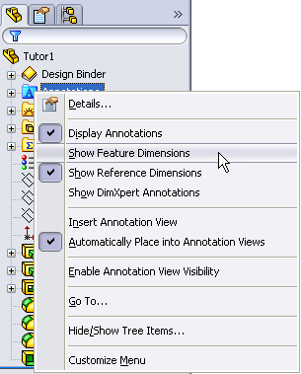
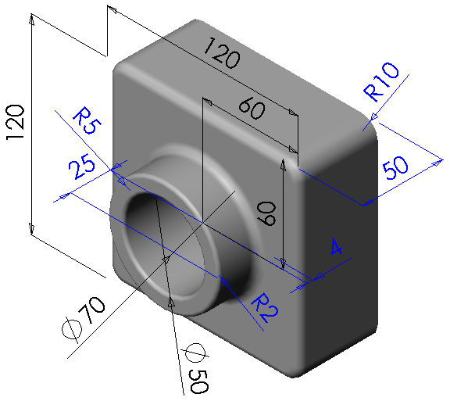
To Display Feature Dimensions
Right-click the Annotations folder, and select Show Feature Dimensions from the shortcut menu.

Slide 10
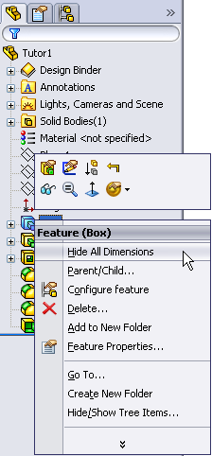
To Hide All the Feature Dimensions for a Selected Feature
Right-click the feature in the FeatureManager design tree, and select Hide All Dimensions from the shortcut menu.

Slide 11
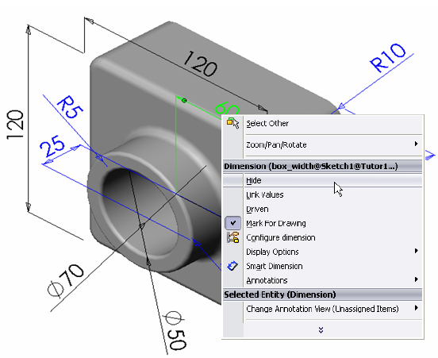
To Hide Individual Dimensions
Right-click the dimension, and select Hide from the shortcut menu.

Slide 12
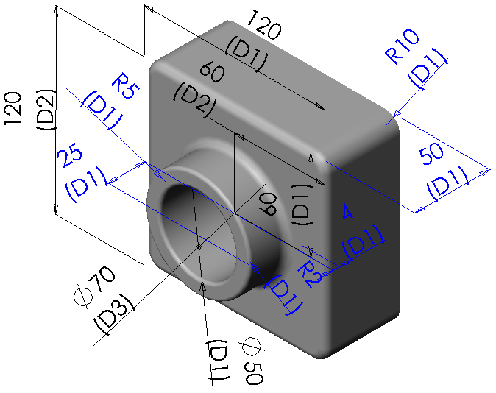
To Display Dimension Names
Click Tools, Options.
Click General on the System Options tab.
Click Show dimension names.
Click OK.

Slide 13
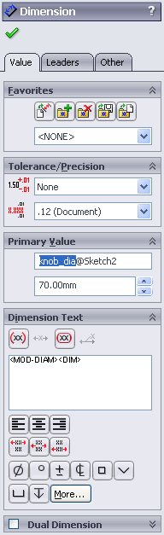
To Rename a Dimension
Display the dimension.
  Either double-click the feature to display its dimensions.
  Or, right-click the Annotations folder, and select Show Feature Dimensions.
Click the 70mm diameter dimension, and in the PropertyManager, rename the dimension to knob_dia, then click OK.
Note: “@Sketch2” is automatically added to the dimension name.

Slide 14
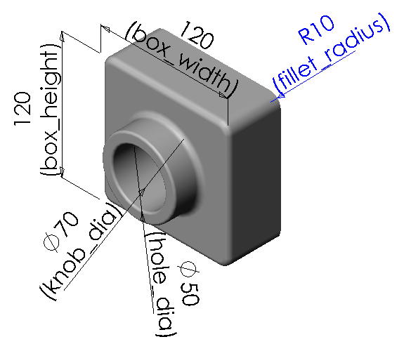
Rename these Dimensions
Height of the box to box_height.
Width of the box to box_width.
Diameter of the hole in the knob to hole_dia.
Radius of outside corners to fillet_radius.

Slide 15
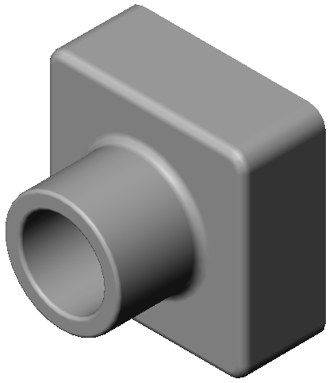
Design Intent
The depth of the Knob should always be equal to the depth of the Box (the base feature).
The Knob should always be centered on the Box.
Dimensions alone are not always the best way to capture design intent.

Slide 16
Linking Values
The Link Values command relates dimensions to each other through shared variable names.
If the value of one linked dimension is modified, then all of the linked dimensions are modified.
Link Values is excellent for making feature dimensions equal to each other.
This is an important tool for capturing design intent.

Slide 17
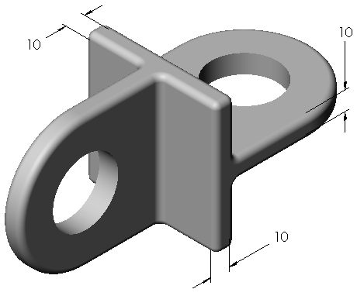
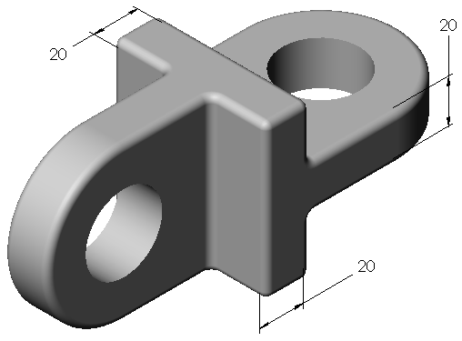
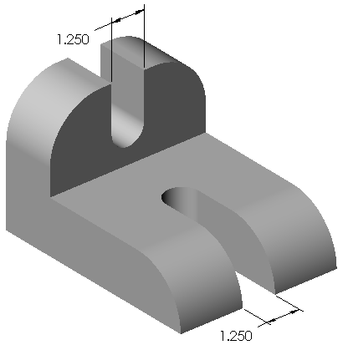
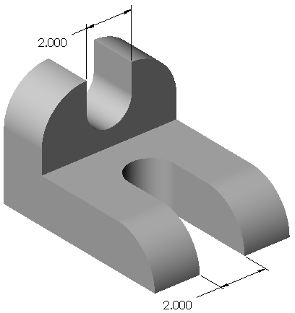
Examples of Uses for Link Values
The thickness of the square and the two tabs is always equal.
The width of both slots is always equal.

Slide 18
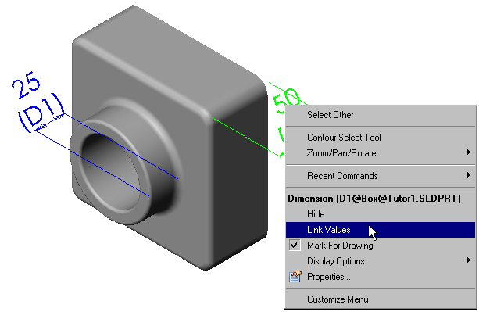
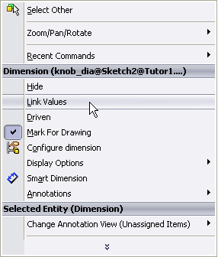
Link the Depth of the Box to the Depth of the Knob
Display the dimensions.
Right-click on the depth dimension for the Box, and select Link Values from the shortcut menu.

Slide 19
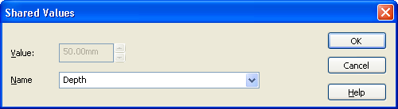
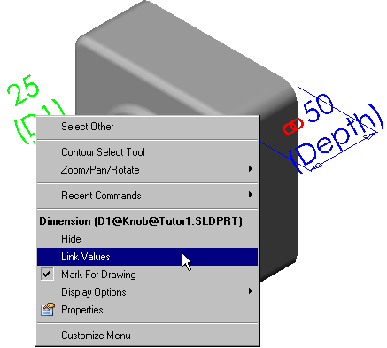
Linking the Box to the Knob
Type Depth in the Name text box and then click OK.
Right-click on the depth dimension for the Knob, and select Link Values from the shortcut menu.

Slide 20
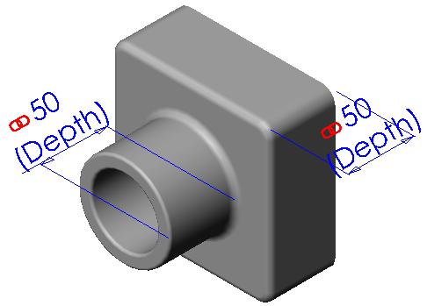
Linking the Box to the Knob
Select Depth from the list, and click OK.
Both dimensions have the same name and value.
Rebuild the part to update the geometry.
Tip: Use the CTRL key to select several dimensions at the same time and link them in one step.

Slide 21
Geometric Relations
Relate geometry through physical relationships such as:
  Concentric
  Coradial
  Midpoint
  Equal
  Collinear
  Coincident

Slide 22
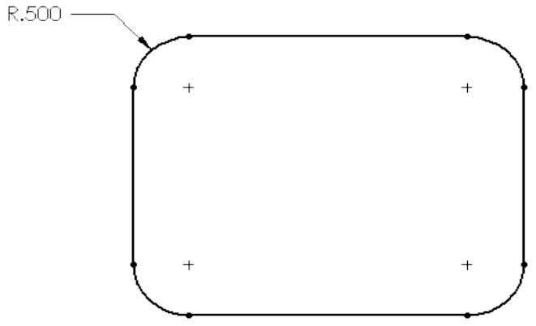
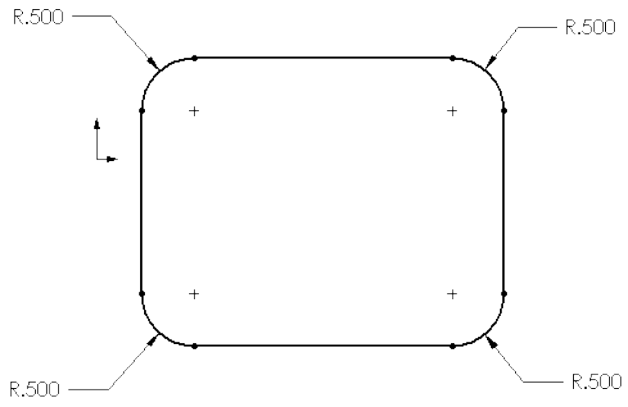
Examples of Geometric Relations
The Sketch Fillet tool automatically creates one radial dimension and 3 Equal relations.
Changing the dimension changes all 4 fillets.
This technique is better than having 4 radial dimensions.

Slide 23
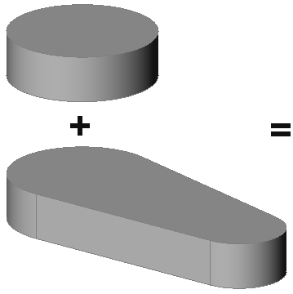
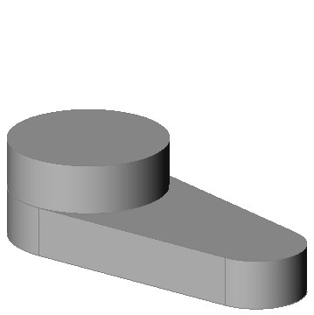
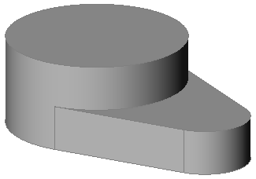
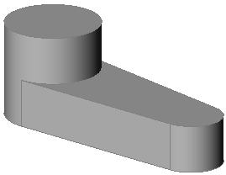
Examples of Geometric Relations
Two features.
Making the circle for the boss Coradial with the edge of the base ensures that the boss will always be the correct size regardless of how the base changes.
Or

Slide 24
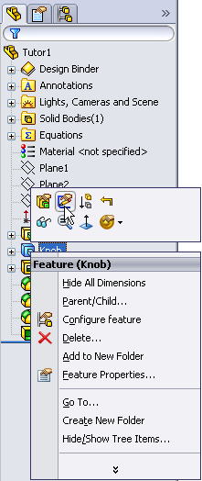
To Center the Knob on the Box
Right-click the Knob feature, and select Edit Sketch from the shortcut menu.

Slide 25
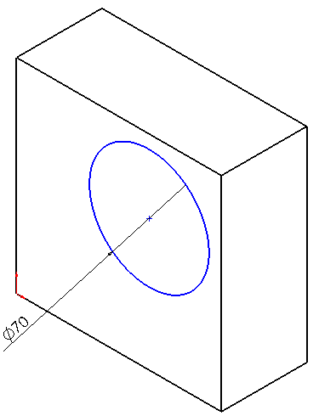
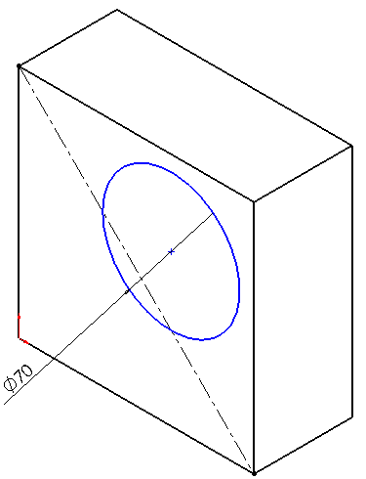
Centering the Knob on the Box
Delete the linear dimensions.
Notice the circle is blue, indicating it is under defined.
Drag the circle to one side. Without dimensions to locate it, it is free to move.
Click , and sketch a diagonal Centerline.

Slide 26
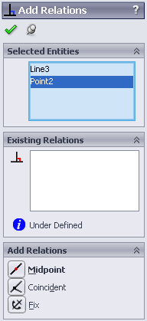
Centering the Knob on the Box
Click Add Relation .
Select the centerline and the point at the center of the circle.
  Note: If the centerline is still highlighted when Add Relations opens, the line automatically appears in the Selected Entities list and you do not have to select it again.
  If you select the wrong entity, right-click in the graphics area, and select Clear Selections.

Slide 27
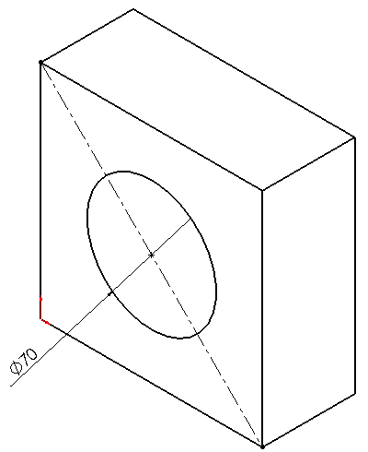
Centering the Knob on the Box
Click Midpoint, and then click Apply and Close.
The circle will now stay centered on the Box feature.

Slide 28

Centering the Knob on the Box
Click Rebuild to exit the sketch and rebuild the part.

Slide 29
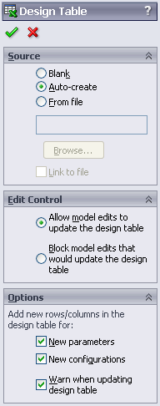
To Insert a New Design Table
Position the part in the lower right hand corner of the graphics area.
Click Insert, Design Table.
The PropertyManager appears.
Select the Auto-create option to create a new design table automatically .

Slide 30
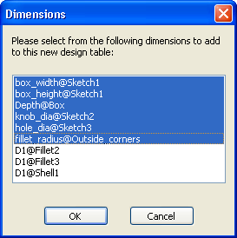
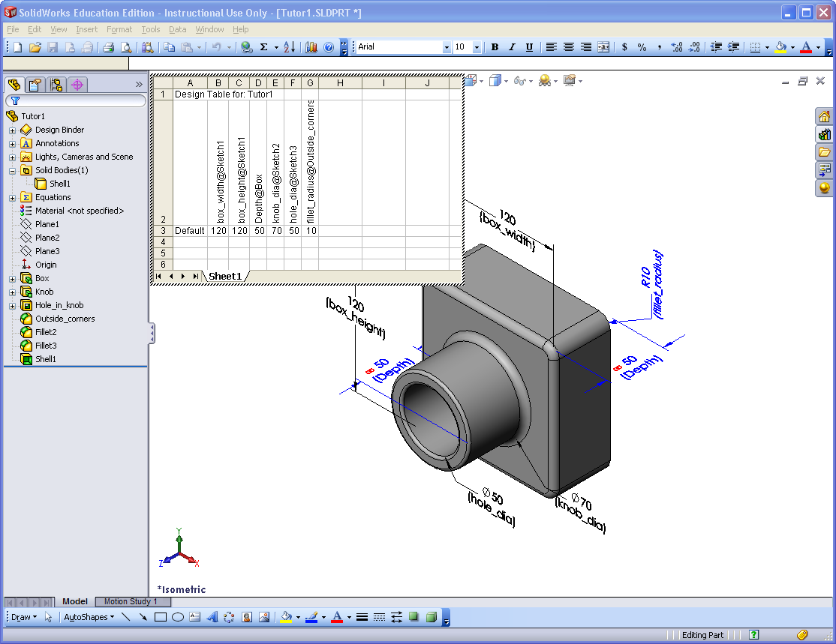
Inserting a New Design Table

Slide 31
Inserting a New Design Table
An Excel worksheet is displayed in the part document window.
Excel toolbars replace the SolidWorks toolbars.
By default, the first configuration is named Default. You can (and should) change this to something more meaningful.

Slide 32
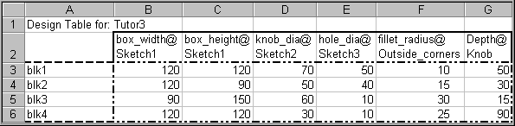
Review of a Design Table’s Format
Dimension and/or Feature names
or special keywords go in this row.
Configuration names
go in this column.
Values go here.

Slide 33


Inserting a New Design Table
Double-click the box_width dimension.
The full dimension name is inserted into cell B2. The dimension value is inserted into cell B3.
The next cell, C2, is automatically selected.
Double-click the box_height dimension.

Slide 34
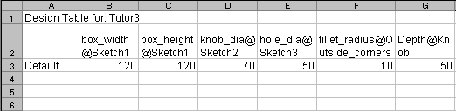
Inserting a New Design Table
Repeat this process for knob_dia, hole_dia, fillet_radius, and Depth.
  Note: Since the depth dimensions of the Knob and the Box are linked together, you only need one of them in the design table.
Excel tip: Dimension names tend to be very long. Use the Excel command Format, Cells, and click Wrap Text on the Alignment tab.

Slide 35
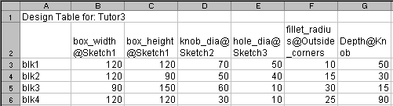
Inserting a New Design Table
Enter new configuration names in column A:
  Replace Default with blk1.
  Fill cells A4 through A6 with blk2, blk3, and blk4.
Fill in the dimension values as shown below.

Slide 36
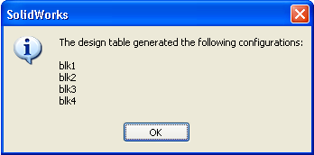
To Close the Excel Worksheet
Click in the graphics area outside the worksheet.
The system builds
the configurations.
Click OK.
The Design Table is
embedded and
stored in the part document.
The design table icon appears in the FeatureManager.
Save the part document.

Slide 37
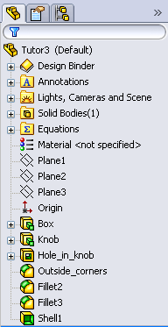
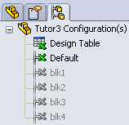
To View Part Configurations
Click the Configuration
Manager tab at the
bottom of the
FeatureManager
window.
The list of
configurations is
displayed.
Double-click each
configuration.

Slide 38
Viewing Part Configurations
The part is automatically rebuilt using the dimension values from the design table.

Slide 39
Mechanics of Solids
Exterior Loads
Interior Loads
Material properties

Slide 40
Exterior Loads
Forces and loads acting on the outside of the body
Free Body Diagrams
  Known loads
  Replace attachments with forces and moments

Slide 41
Newtons Laws
The fundamental principles of mechanics
First Law
If the resultant forces acting on a body are zero:
  Body will remain at rest, or
  Body will move with constant velocity
Second Law
If the resultant forces acting on a body are not zero:
  Body will accelerate proportional to the magnitude of resultant force.
Third Law
Forces of action and reaction between bodies in contact have same magnitude and opposite direction

Slide 42
Internal Forces
Stress
  Measure of force per unit area
  Units
    Pounds per square inch
    Newtons per square meter
Strain
  Measure of elongation
  Units - length/length
    inches per inch
    millimeters per millimeter

Slide 43
Internal Forces
Deformation
  The result from totaling all the internal strain

Slide 44
Finite Element Analysis
Numerical method
  Part is broken into many small elements (meshing)
  Matrix of equations describe the relationship between elements
  Equations solved simultaneously
Used to solve problems in:
  Machine design
  Acoustics
  Electromagnetics
  Solid mechanics
  Fluid dynamics

Slide 45
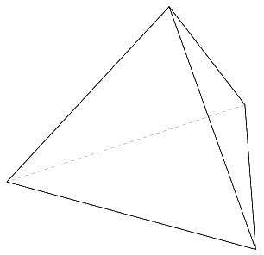
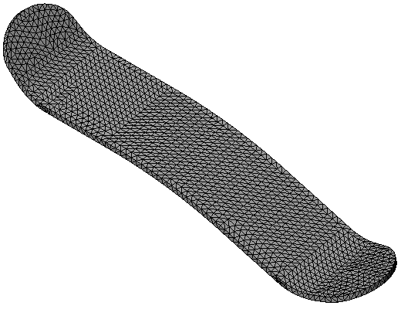
Meshing
During the meshing operation,
the model is broken into many tetrahedral elements.
The tetrahedral elements
are not infinitesimal.
SolidWorks Simulation can use
other element shapes,
SimulationXpress only
uses tetrahedrons.

Slide 46
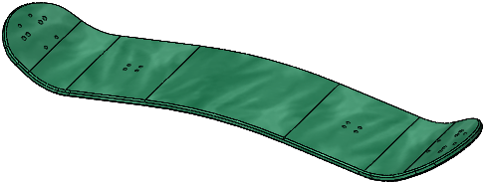
The Mountainboard
The Deck
Design Intent
  The Deck will be created as a laminated piece
  Symmetric front to back and side to side
  Mounting holes for Bindings
  Mounting holes for Trucks

Slide 47

SolidWorks SimulationXpress
Linear Static Analysis
  Linear – The Stress-
  Strain curve is a straight
  line
  Static - Loads are
  applied slowly
Wizard driven
  Follow the on screen
  instructions

Slide 48
Analysis Procedure
The basic steps for analysis are:
Material - material can be added in either:
  SolidWorks
  SimulationXpress
Restraints
  Fixed - A fixed restraint stops all movement
Loads
  Force - force can either be applied normal to the surface or normal to a selected plane or face.
  Pressure - pressure is always normal to a surface

Slide 49
Analysis Procedure
Run
  Model is meshed
  Deflection, Strain and Stress are calculated
Output
  Factor of Safety (FOS)
  Stress - Force divided by area
  Strain - Elongation per unit length
  Displacement - Total elongation from rest
  Report
  eDrawing

